Slide 1

Near Earth Objects Catina, Kevin, & Rolando Group 2

Slide 2
Agenda
Background
Proposal
Data (?)
Trends / Correlations
Predictions
Conclusion
Next Steps
Q & A

Slide 3

Background
Infinite number of objects in space.
Pose potential threat to Earth.
Which objects can harm us?
Certified asteroids = NASA - Nearest Earth Objects

Slide 4

Proposal
Develop a model to determine if a near-Earth objects pose a threat to satellites, disrupts natural phenomena, or is likely to impact Earth. Utilize data from NASA’s Near-Earth Object Web Service for the model creation and testing.

Slide 5
Findings:
Random Forest is in the lead.
Badly imbalanced data
- Model is not so good at picking the "hazardous" outcome (minority)
- Optimization work will be to lower the occurrences of "false positives“
[x] Preprocess Data
- Ensuring data is numerical and not string
Scale using StandardScaler and MinMaxScaler (Standard performed better - only just)
True/False outcomes were turned in 0,1 outcomes when the data was pulled from the API

Slide 6
Data

Slide 7
Preditions (?) PLACEHOLDER
Xsssssss
Xxxxxx
Xxxxxxxx
Xxxxxx
Xxxxxx
Xxxxxx
Xxxxx

Slide 8

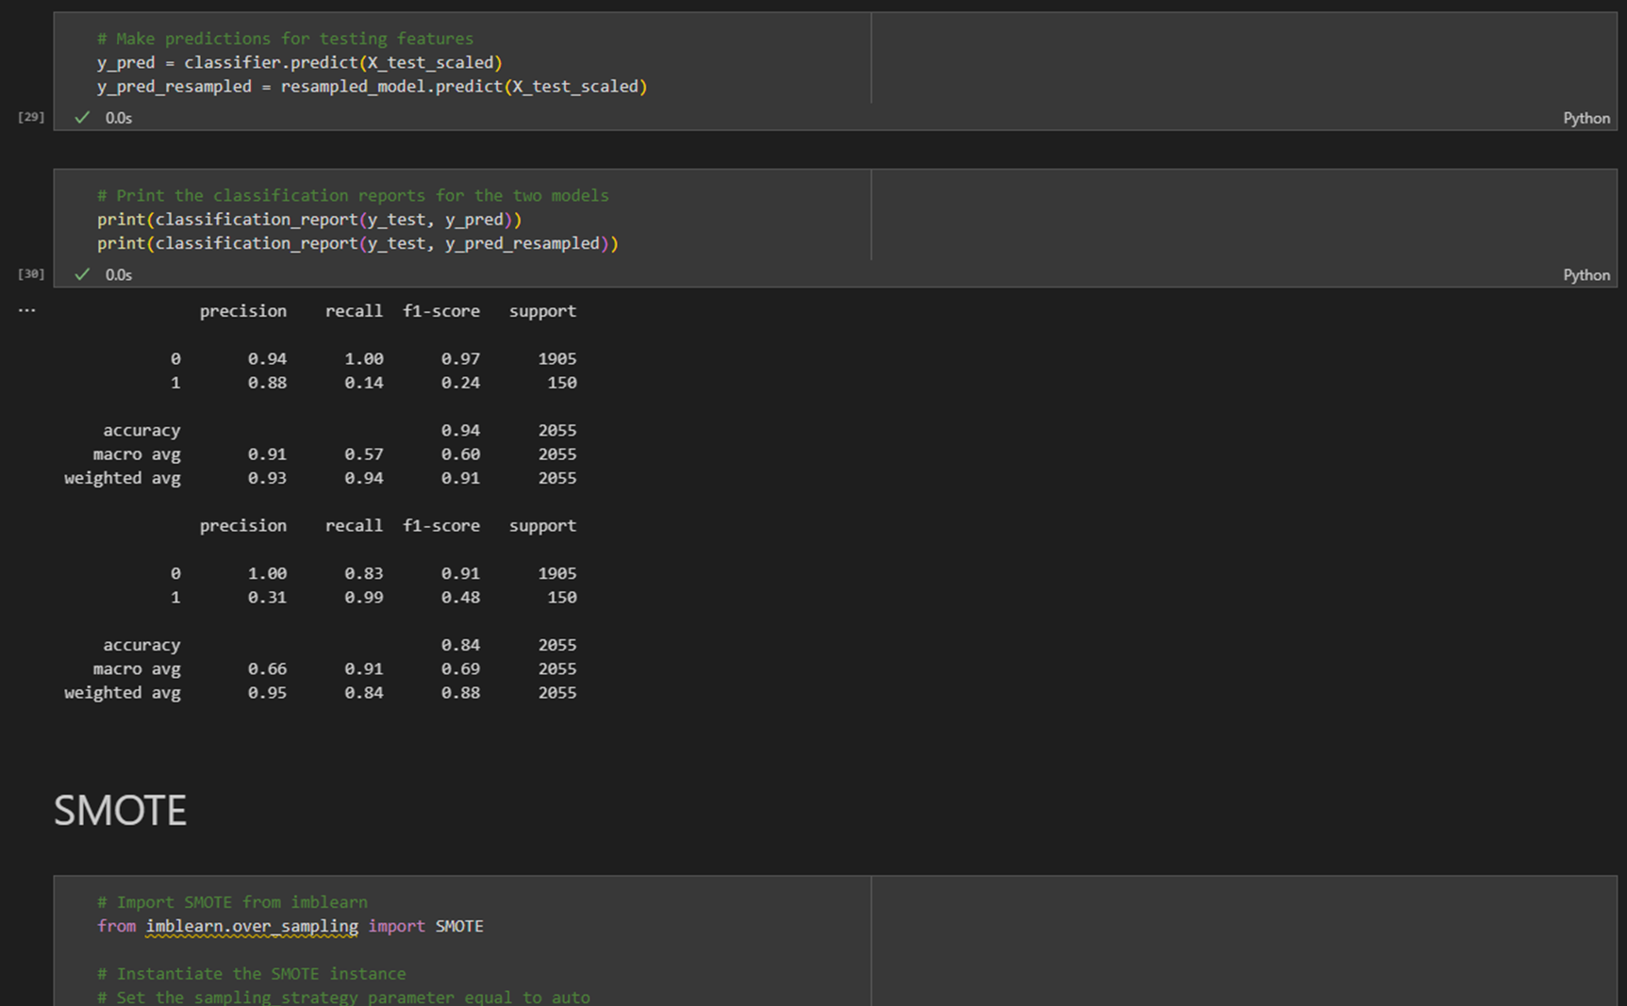
Trends & Correlations
XXXXXXX
XXXXXX
Placeholder please redo using data;
make visually pleasing

Slide 9
Trends & Correlations Placeholder
Bullets or sentences
Bullets or sentences
Metric | Measurement | Target | Actual
Audience attendance | # of attendees | 150 | 120
Engagement duration | Minutes | 60 | 75
Q&A interaction | # of questions | 10 | 15
Positive feedback | Percentage (%) | 90 | 95
Rate of information retention | Percentage (%) | 80 | 85

Slide 10
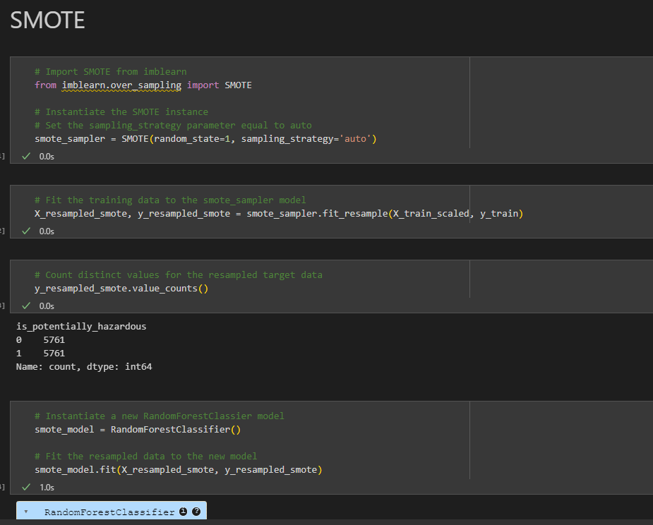
Highlight the use of SMOTE SOMEHOW
Placeholder please redo using data;
make visually pleasing

Slide 11
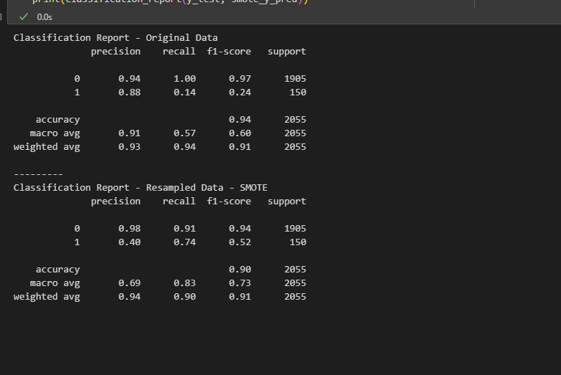
Highlight the use of RESAMPLED DATA - SMOTE
RESAMPLED DATA – SMOTE
HIGHLIGHT DIFFERENCES
Placeholder please redo using data;
make visually pleasing

Slide 12

Conclusion
Xxxxxxxxx xxxxxxxxxxxxxxxxxxxxxx xxxxxxxxxx
Ssssssssssss sssssss ssssssssssssss. Ssssssssssssssssss
Xsssssssssssssssssss

Slide 13

Questions

Slide 14
Extra slides – delete after final copy

Slide 15
Xxxxxxxxxxxxxxxx
Xxxxx
Xxxxxxx
Xxxxx

Slide 16

The power asylum

Slide 17
Navigating Q&A sessions
Know your material in advance
Anticipate common questions
Rehearse your responses
Maintaining composure during the Q&A session is essential for projecting confidence and authority. Consider the following tips for staying composed:
Stay calm
Actively listen
Pause and reflect
Maintain eye contact

Slide 18
Final tips & takeaways
Consistent rehearsal
Strengthen your familiarity
Refine delivery style
Pacing, tone, and emphasis
Timing and transitions
Aim for seamless, professional delivery
Practice audience
Enlist colleagues to listen & provide feedback
Seek feedback
Reflect on performance
Explore new techniques
Set personal goals
Iterate and adapt

Slide 19
Speaking engagement metrics
Impact factor | Measurement | Target | Achieved
Audience interaction | Percentage (%) | 85 | 88
Knowledge retention | Percentage (%) | 75 | 80
Post-presentation surveys | Average rating | 4.2 | 4.5
Referral rate | Percentage (%) | 10 | 12
Collaboration opportunities | # of opportunities | 8 | 10

